Slide 1
Simulation
Stochastic modeling

Slide 2
Random objects
Random events
Random variables
Random processes
Random point processes

Slide 3
Random processes
simulation

Slide 4


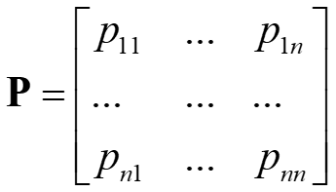

(discrete-time) Markov chain
States:
1, 2, …, n
Transition epochs:
1, 2, …
Markov property: the conditional probability distribution of future states of the process depends only on the current state, not on any the previous
Transition probabilities:

Slide 5
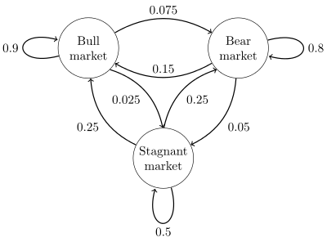
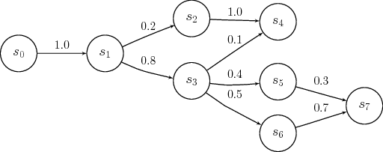
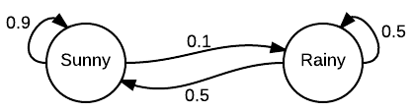
(discrete-time) Markov chain
Twitter botnet

Slide 6
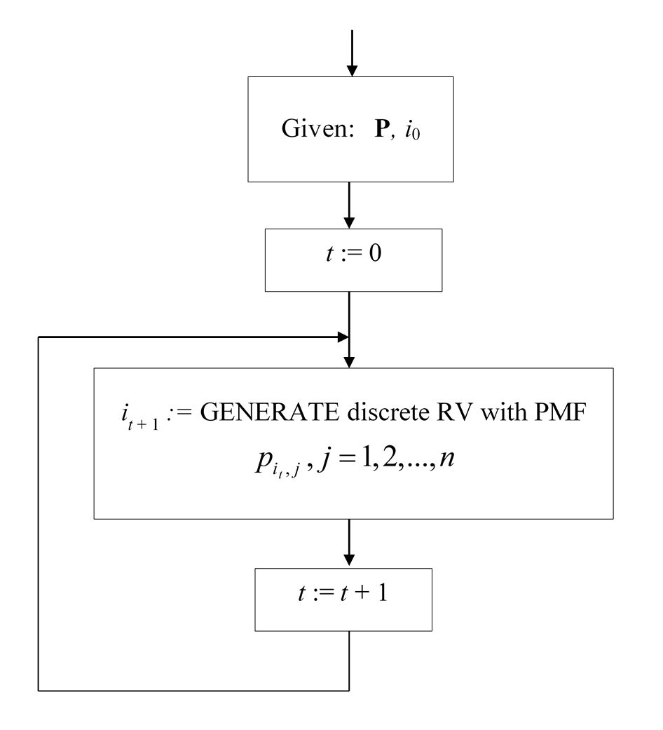
Markov chain simulation

Slide 7

Laboratory #9
Assignment:
One-eye bandito
After the player presses the button, the indicator accepts one of the colors arranged in the following order: green, yellow, red. Colors are arranged in the specified order in a single line. It is known that the probability of a transition to an adjacent color is equal to 0.4, the probabilities that the color does not change, or that the transition is made to a non-neighboring color are equal each other.
The player bets on the next color and wins 2 times more if he guessed.

Slide 8

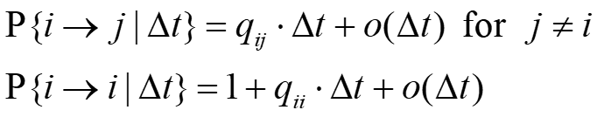
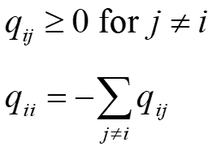
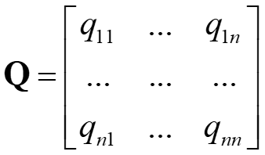
Continuous-time Markov process
States:
Rates of transitions:
Transition rate matrix:
infinitesimal generator matrix

Slide 9
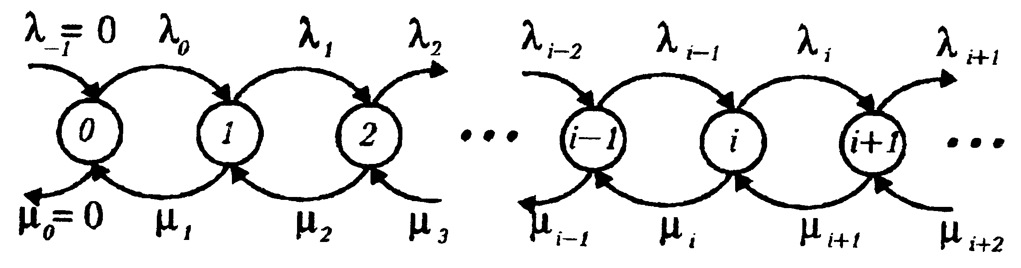
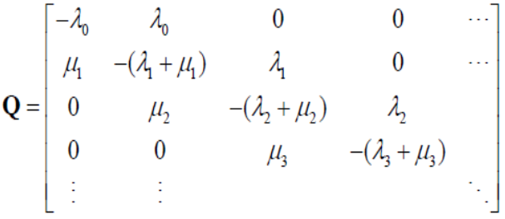
Continuous-time Markov process
EXAMPLE
Birth-and-death process (BDP)

Slide 10
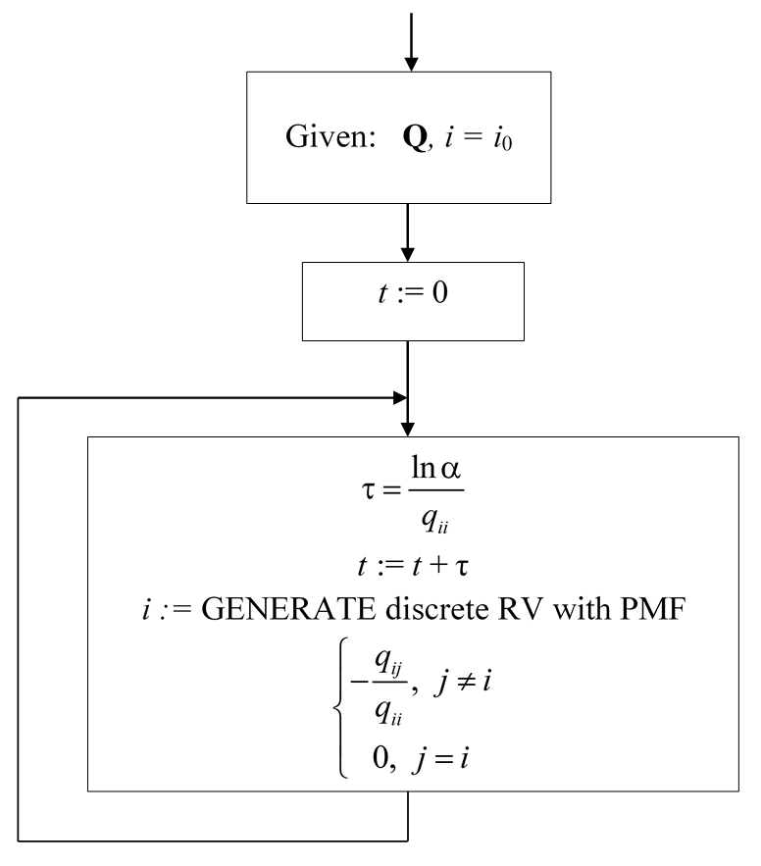
Continuous-time Markov process simulation

Slide 11
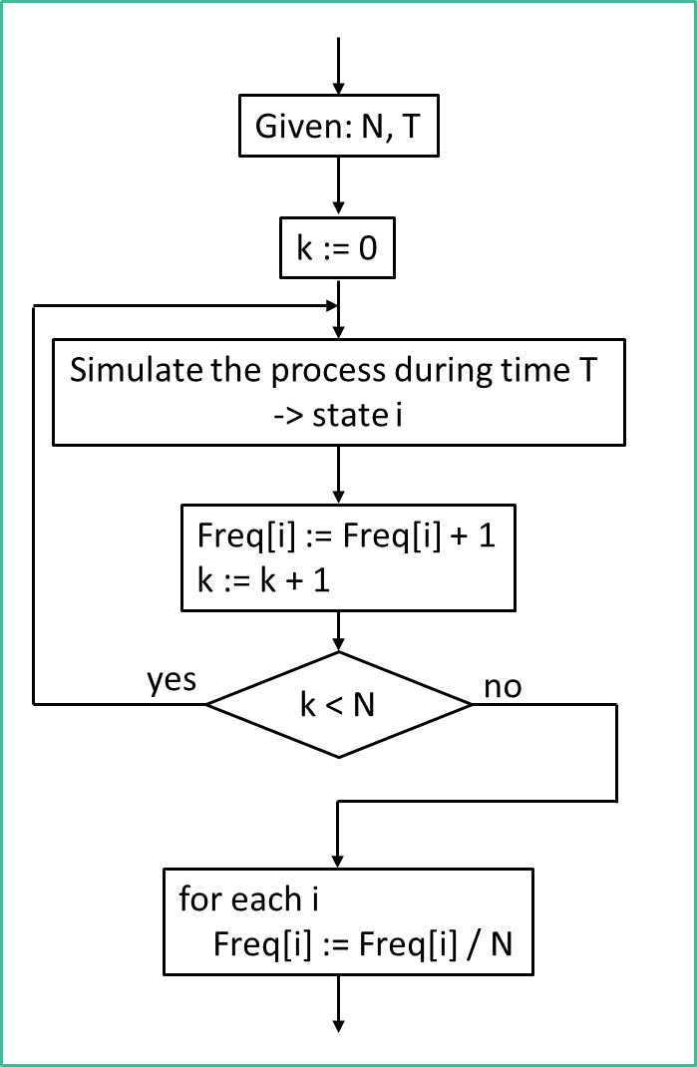
Statistical processing for random processes
Algorithm 1
State | 1 | 2 | … | n
Frequency | 112 | 83 | … | 71

Slide 12
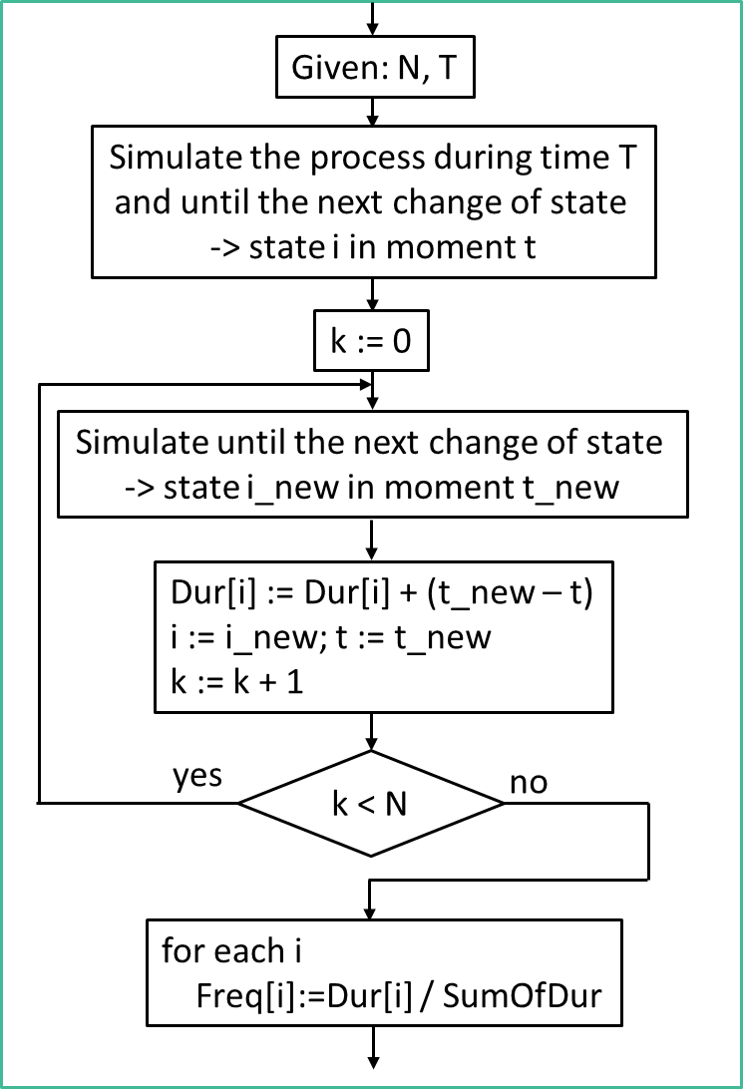
Statistical processing for random processes
Algorithm 2
State | 1 | 2 | … | n
Duration | 12.087 | 7.449 | … | 16.328

Slide 13
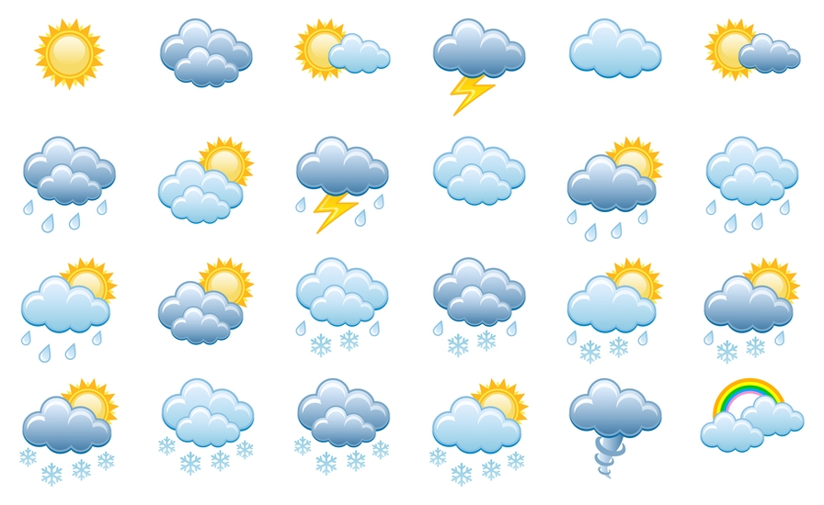
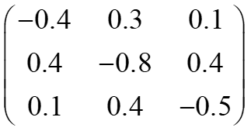
Laboratory #15
Assignment:
Weather simulation
Example. Let state 1 means clear, state 2 means cloudy, and state 3 means overcast.
You may use the following transition rate matrix (time unit = 1 day):
Task: Simulate with visualization. Make statistical processing. Show stationary distribution

Slide 14
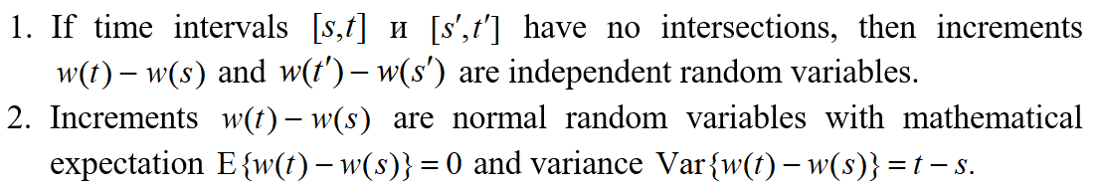
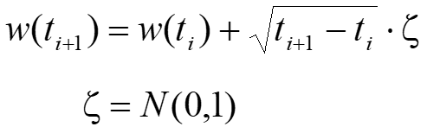
Wiener process (Brownian motion)
GENERATOR:

Slide 15
Arithmetic Brownian motion
μ is called as a drift and σ is called as a volatility parameter (standard deviation)
GENERATOR:

Slide 16

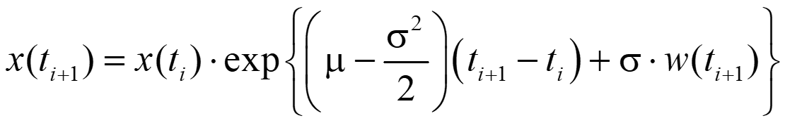
Geometric Brownian motion
μ is a drift and σ is a volatility
GENERATOR:
do it yourself

Slide 17
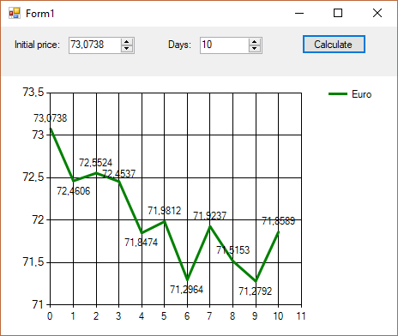

Laboratory #16
= #4 new version
Assignment:
Currency exchange game
Modify model using Geometric Brownian motion

